Slide 1

stream
e

Slide 2

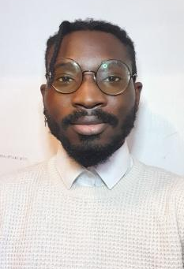
introductions
CANDIDATE SUMMARY
Aaron Banjoko
BEng Electronics and
Communications Engineering 2:1
Aaron is an extraordinary creative thinker with a powerful drive towards creative solutions and problem solving. With a 2:1 in BEng Electronics and Communications from the University of Sheffield, he has developed a mindset that is independent, responsible and reliable. Additionally, his strong desire to learn led him to base his final year project on developing android applications measuring 4G network parameters.
An enthusiastic learner with great teamwork skills, his positive nature naturally acts as a catalyst to develop the potential in his colleagues. A passion for music composition and gaming developed remarkable perseverance and astounding mindset for crisis management.
2#
3#
4#
5#

